Slide 1

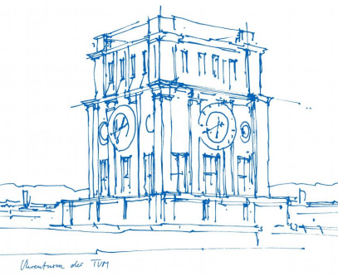
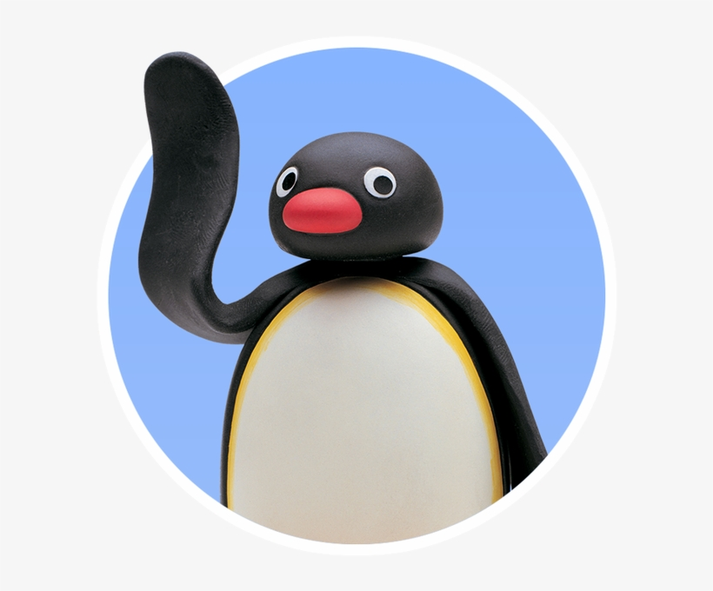
Interaction Prototyping
Lehrstuhl für Ergonomie TUM School of Engineering and Design Technical University of Munich
Usability Requirements & Heuristic Analysis
The Rolling Penguins
Vincent Brunner Beatrice Seibert Stefano Ferrari
Winter Semester 2021/2022

Slide 2
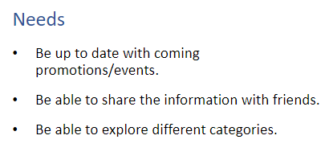
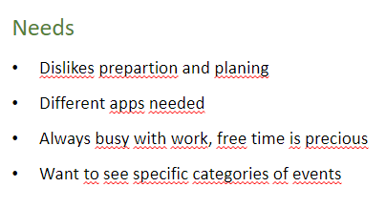
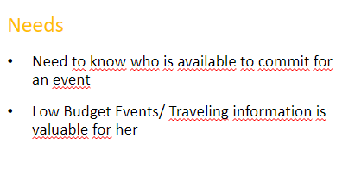
Lehrstuhl für Ergonomie TUM School of Engineering and Design Technical University of Munich
Usability Requirements
For the usability requirements the first step was to expand the user scenarios into a concrete situation. Therefore, allowing us to abstract the requirements from the specified event.
To recapitulate, the previous identified needs from the personas were the following:
Marc Alvarado
Paul Schöffel
Christine Mayer
Vincent Brunner | Beatrice Seibert | Stefano Ferrari| Interaction Prototyping| Winter Semester 2021/2022
1

Slide 3
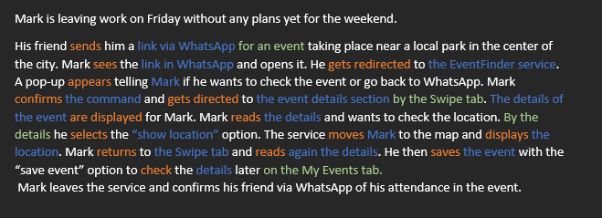

Lehrstuhl für Ergonomie TUM School of Engineering and Design Technical University of Munich
Usability Requirements – Persona 1 (Mark Alvarado)
Open (action) invitation link (object) from external app (context)
Personalize suggestions (action) from the filter feature (object)
Track location (action) from the phone (object)
Place (action) location from phone (object) into a new city (context)
Receive information regarding event from inside the app
Show (action) event/building (object) in the Map Section (context)
Search (action) a specific kind of event (object)
Confirm (action) attendance in the event (object)
Set (action) time reminder for notification (object)
Send (action) notification (object) via phone notifications (context)
Vincent Brunner | Beatrice Seibert | Stefano Ferrari| Interaction Prototyping| Winter Semester 2021/2022
2

Slide 4
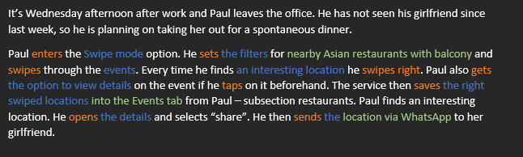
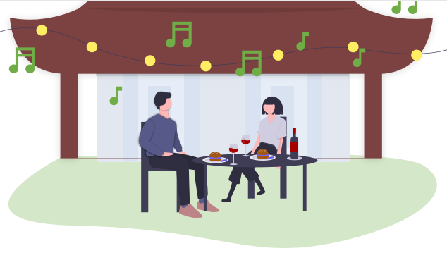
Lehrstuhl für Ergonomie TUM School of Engineering and Design Technical University of Munich
Usability Requirements – Persona 2 (Paul Shöffel)
Send (action) invitation link from an event (object)
Notify (action) user (object) that he is going to enter the app (with accept/decline) (context)
Direct (action) user(object) to a specific sub-section of the service (context)
Redirect (action) user (object) to another sub-section of the service (inside of the app) (context)
Bookmark (action) location/event (object) into the My Events sub-section (context)
Vincent Brunner | Beatrice Seibert | Stefano Ferrari| Interaction Prototyping| Winter Semester 2021/2022
3

Slide 5
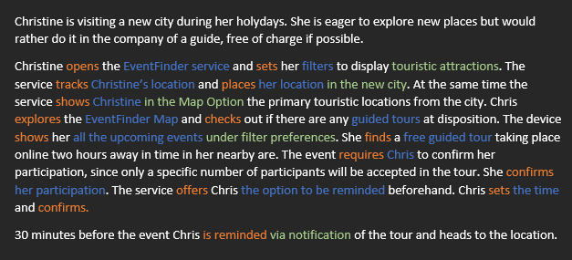
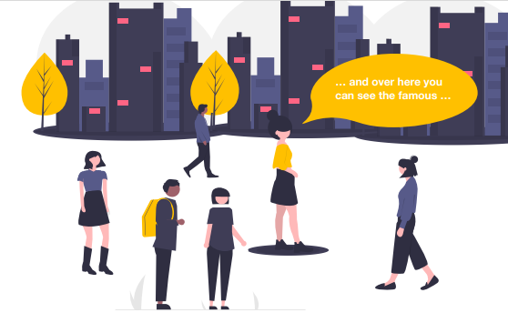
Lehrstuhl für Ergonomie TUM School of Engineering and Design Technical University of Munich
Usability Requirements – Persona 3 (Christine Mayer)
Select (action) sub-section from the service (object)
Swipe (action) through the events(object) in the service (context)
Open (action) detail information from event (object)
Save (action) selected events (object) into the bookmarking section (context)
Send (action) a specific event (object) via social network to contact (context)
Vincent Brunner | Beatrice Seibert | Stefano Ferrari| Interaction Prototyping| Winter Semester 2021/2022
4

Slide 6
Lehrstuhl für Ergonomie TUM School of Engineering and Design Technical University of Munich
Usability Requirements – Summary
Open (action) invitation link (object) from external app (context)
Send (action) a specific event (object) via social network to contact (context)
Personalize suggestions (action) from the filter feature (object)
Track location (action) from the phone (object)
Place (action) location from phone (object) into a new city (context)
Show (action) event/location (object) in the Map Section (context)
Search (action) a specific kind of event (object) (Ex. Wine tasting) (Not filtering)
Confirm (action) attendance in the event (object)
Set (action) time reminder for notification (object)
Send (action) notification (object) via phone notifications (context)
Notify (action) user (object) that he is going to enter the app (with accept/decline) (context)
Direct (action) user(object) to a specific sub-section of the service (context)
Bookmark (action) location/event (object) into the My Events sub-section (context)
Swipe (action) through the events(object) in the service (context)
Open (action) detail information from event (object)
Vincent Brunner | Beatrice Seibert | Stefano Ferrari| Interaction Prototyping| Winter Semester 2021/2022
5

Slide 7
Lehrstuhl für Ergonomie TUM School of Engineering and Design Technical University of Munich
Nielsen – Heuristic Analysis
Next, we ran an analysis on each Nielsen Heuristic and gathered relevant points, which were be taken into consideration. Since not all points can be easily integrated into a LoFi prototype, the defined results will be taken into consideration when programming the HiFi prototype.
Results applied to the LoFi prototype can be found in Slides 10-13.
Vincent Brunner | Beatrice Seibert | Stefano Ferrari| Interaction Prototyping| Winter Semester 2021/2022
6

Slide 8
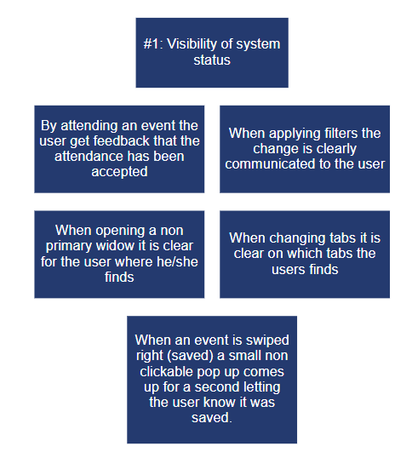
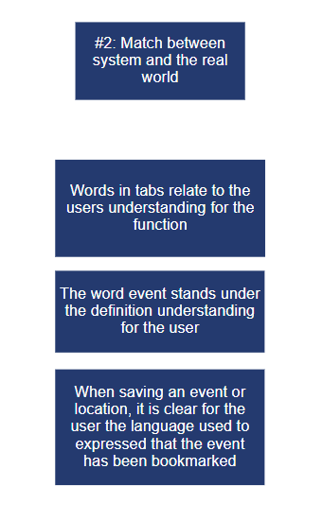
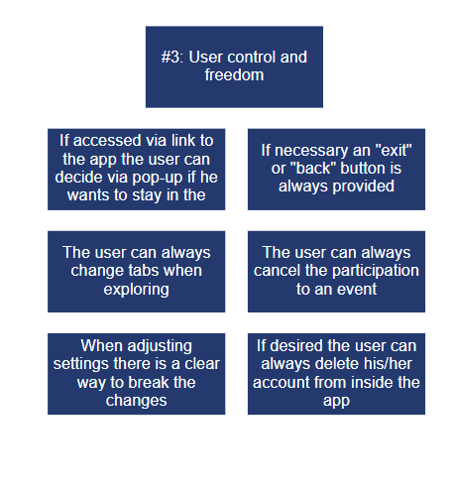
Lehrstuhl für Ergonomie TUM School of Engineering and Design Technical University of Munich
Nielsen – Heuristic Analysis
HiFi
HiFi
HiFi
HiFi
Vincent Brunner | Beatrice Seibert | Stefano Ferrari| Interaction Prototyping| Winter Semester 2021/2022
7

Slide 9
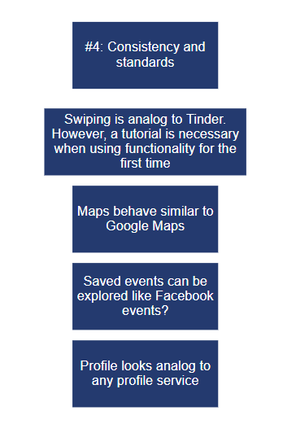
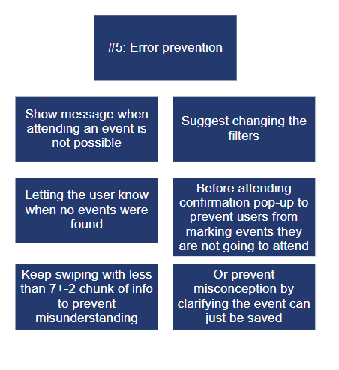
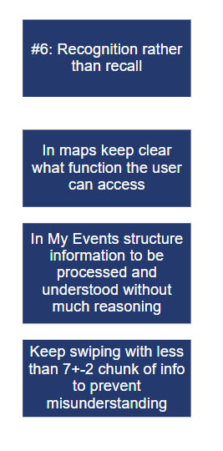
Lehrstuhl für Ergonomie TUM School of Engineering and Design Technical University of Munich
Nielsen – Heuristic Analysis
HiFi
HiFi
HiFi
HiFi
HiFi
HiFi
Vincent Brunner | Beatrice Seibert | Stefano Ferrari| Interaction Prototyping| Winter Semester 2021/2022
8

Slide 10
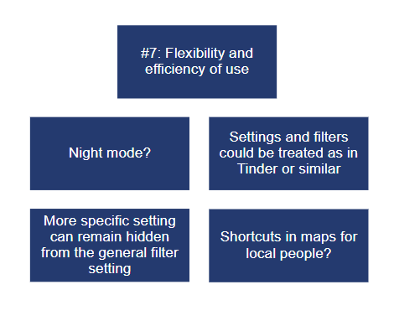
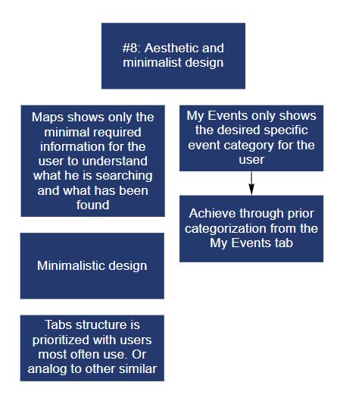
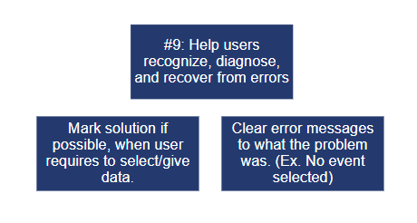
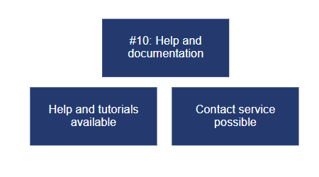
Lehrstuhl für Ergonomie TUM School of Engineering and Design Technical University of Munich
Nielsen – Heuristic Analysis
HiFi
HiFi
HiFi?
HiFi?
HiFi
HiFi
HiFi (partly)
HiFi
Vincent Brunner | Beatrice Seibert | Stefano Ferrari| Interaction Prototyping| Winter Semester 2021/2022
9

Slide 11
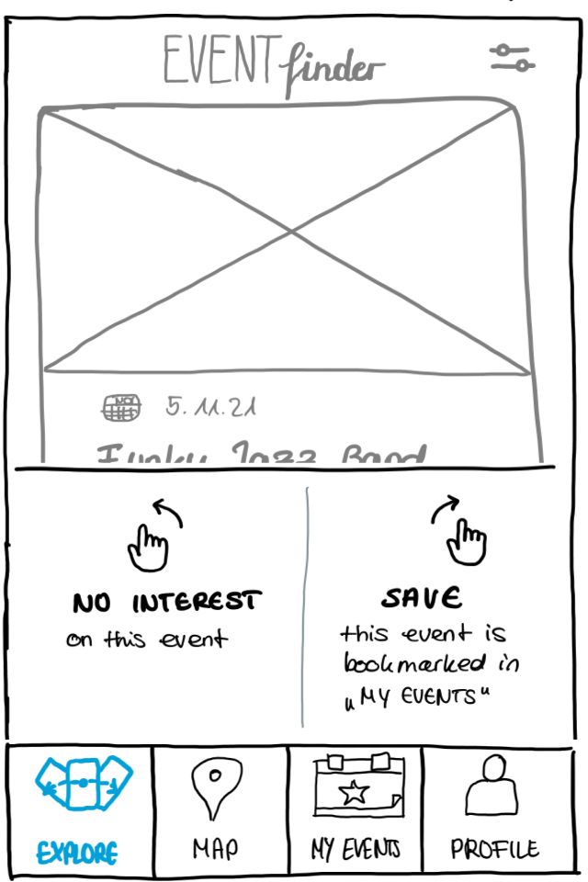
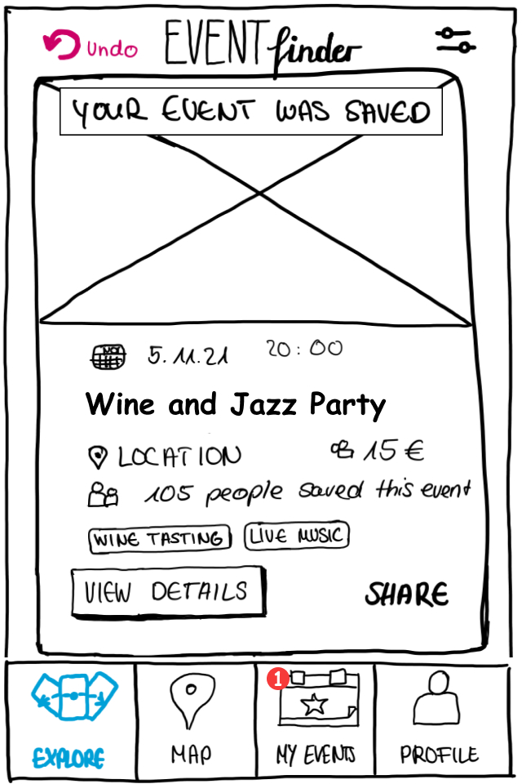


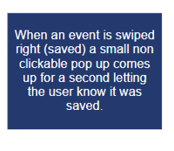
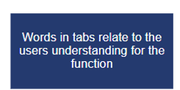
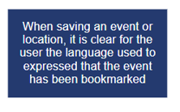
Lehrstuhl für Ergonomie TUM School of Engineering and Design Technical University of Munich
Nielsen – Heuristic Analysis (LoFi Integration)
Vincent Brunner | Beatrice Seibert | Stefano Ferrari| Interaction Prototyping| Winter Semester 2021/2022
10

Slide 12
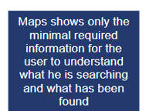
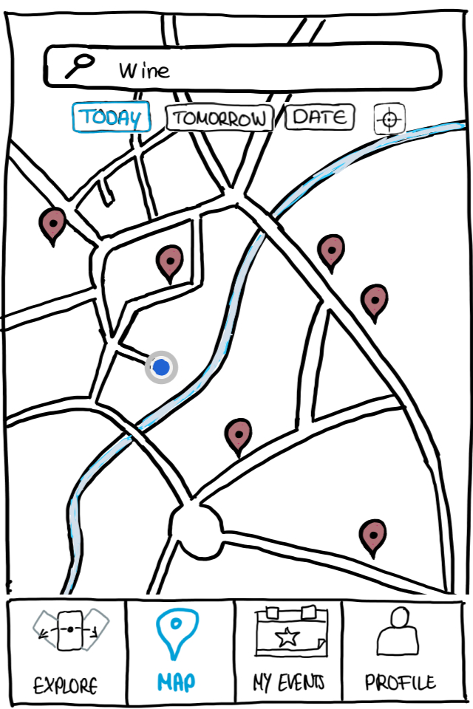
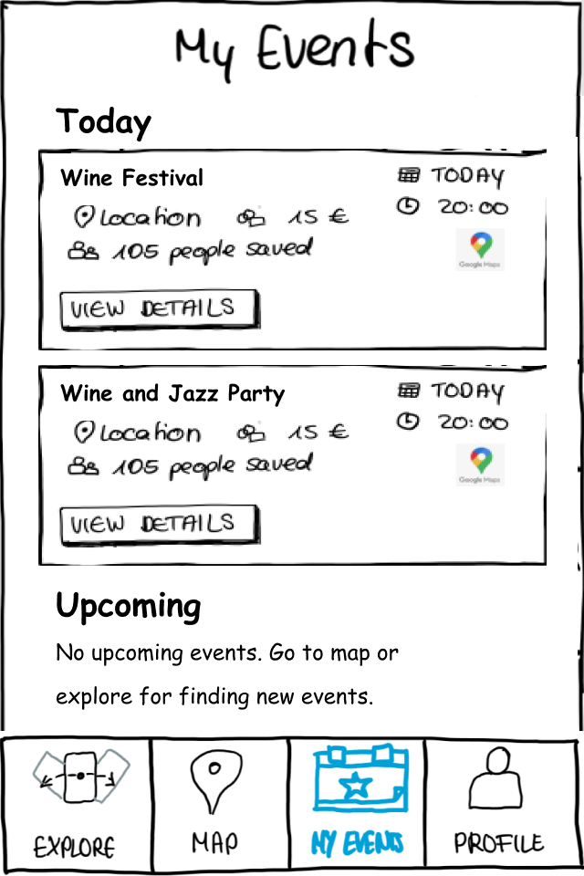
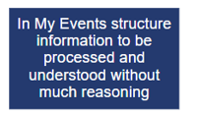
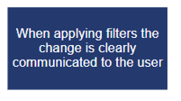
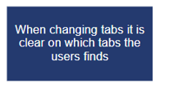


Lehrstuhl für Ergonomie TUM School of Engineering and Design Technical University of Munich
Nielsen – Heuristic Analysis (LoFi Integration)
Vincent Brunner | Beatrice Seibert | Stefano Ferrari| Interaction Prototyping| Winter Semester 2021/2022
11

Slide 13
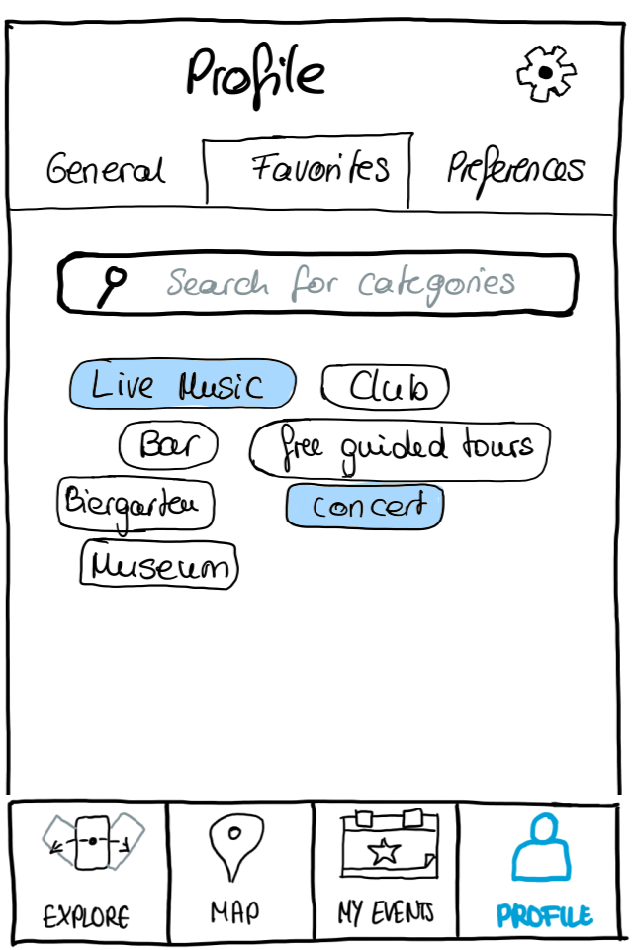


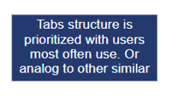
Lehrstuhl für Ergonomie TUM School of Engineering and Design Technical University of Munich
Nielsen – Heuristic Analysis (LoFi Integration)
Vincent Brunner | Beatrice Seibert | Stefano Ferrari| Interaction Prototyping| Winter Semester 2021/2022
12

Slide 14
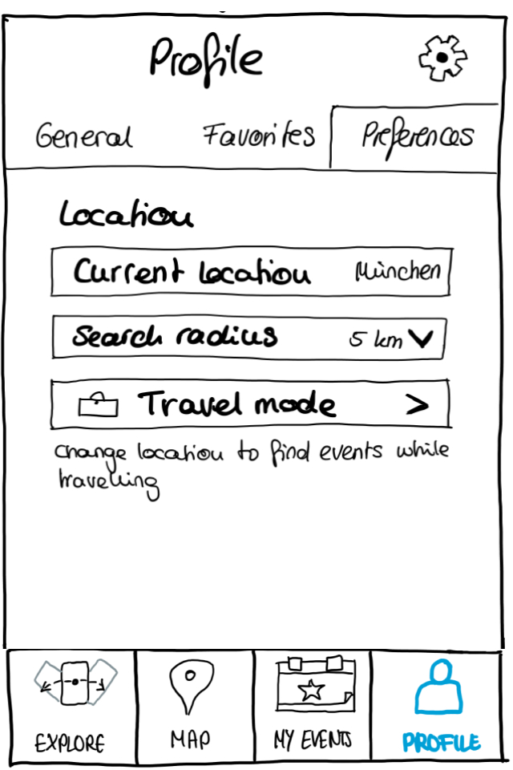
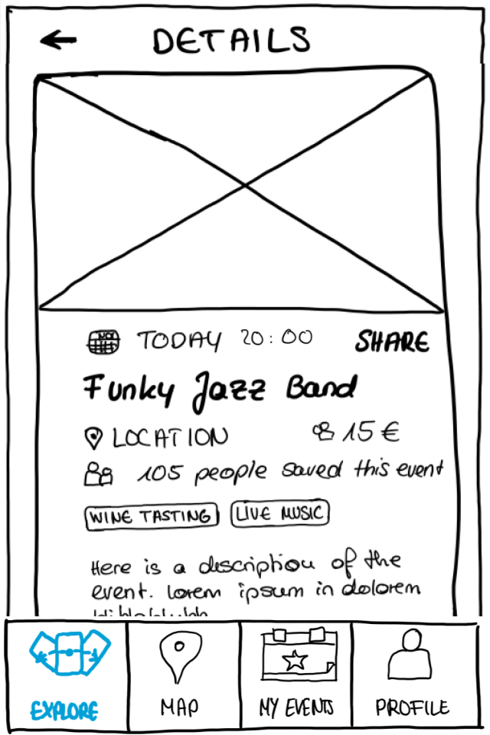
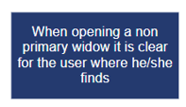
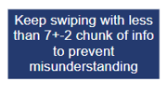
Lehrstuhl für Ergonomie TUM School of Engineering and Design Technical University of Munich
Nielsen – Heuristic Analysis (LoFi Integration)
Vincent Brunner | Beatrice Seibert | Stefano Ferrari| Interaction Prototyping| Winter Semester 2021/2022
13

